Slide 1


Noida Institute of Engineering and Technology, Greater Noida
PROBABILISTIC LEARNING & ENSEMBLE
Unit: 4
MACHINE LEARNING
ACSML0501
Ms. Sonia Arora
Assistant Professor
CSBS Department
B Tech 5th sem
Computer Science and Engineering (DATA SCIENCE)

Slide 2

Subject Syllabus

Slide 3
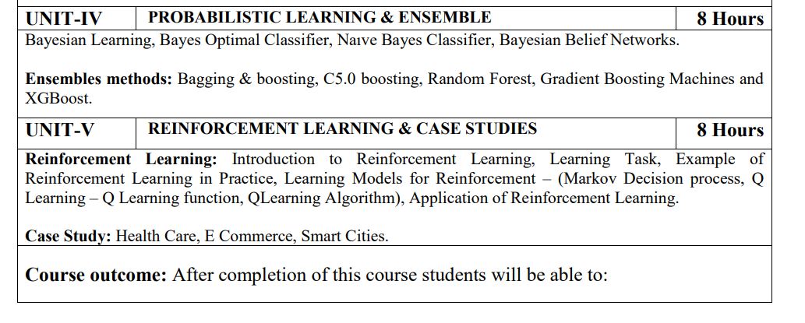
Subject Syllabus

Slide 4
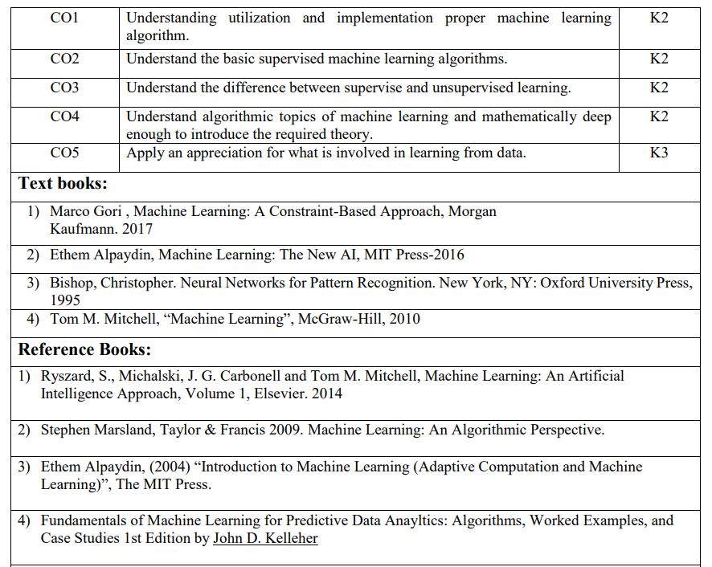
Text Books

Slide 5
Branch Wise Applications
Probabilistic Learning:
Involves training models to predict probabilities instead of fixed outcomes
Useful for tasks with inherent uncertainty, such as classification, regression, and decision-making
Techniques include logistic regression, decision trees, random forests, and neural networks
Ensemble Application:
Combines multiple base models to improve prediction accuracy and robustness
Ensemble methods include bagging, boosting, stacking, and voting
Advantages include reduced overfitting, improved generalization, and increased interpretability

Slide 6
Result Analysis
ML Result of 2021-22: 96.00%
ML Result of 2022-23: 95.80%

Slide 7
Prerequisite
Prerequisites:
Statistics.
Linear Algebra.
Calculus.
Probability.
Programming Languages.

Slide 8
Brief Introduction
Probabilistic Learning:
A machine learning approach that uses probability theory to model uncertainty and make predictions. It learns from data and updates probabilities based on new information. Enables machines to make informed decisions under uncertainty.
Ensemble Applications:
Combine multiple base models to improve prediction accuracy and robustness. Ensembles like bagging, boosting, and stacking reduce overfitting and enhance generalization. Leading to better performance in classification, regression, and other tasks.
https://www.youtube.com/watch?v=Fv_LGQKgWi0&pp=ygUWUHJvYmFiaWxpc3RpYyBMZWFybmluZw%3D%3D
https://www.youtube.com/watch?v=bY1TRB4ky6o&pp=ygUWUHJvYmFiaWxpc3RpYyBMZWFybmluZw==

Slide 9
Unit 4 Content
Bayesian Learning,
Bayes Optimal Classifier
Naıve Bayes Classifier
Probability estimation
Bayesian Belief Networks.
Ensembles methods
Bagging
Boosting
Bagging & boosting and its impact on bias and variance
C5.0 boosting
Random Forest
Gradient Boosting Machines
XGBoost.

Slide 10
Unit Objective
The objective of the Unit 4
study about Probabilistic learning algorithm's.
To study the concept of Bagging and boosting
Random forest
Gradient boosting

Slide 11
Topic Objective
The objective of the topic is to make the student able to understand about :
Bayesian learning.
Recap
Students learnt the unsupervised learning algorithms

Slide 12
Bayesian Learning
Suppose that you are allowed to flip the coin 10 times in order to determine the fairness of the coin.
Observations from the experiment will fall under one of the following cases:
Case 1: observing 5 heads and 5 tails.
Case 2: observing h heads and 10-h tails.
If case 2 is observed you can either:
Neglect your prior beliefs since now you have new data, decide the probability of observing heads is h/10 by solely depending on recent observations.
Adjust your belief accordingly to the value of h that you have just observed, and decide the probability of observing heads using your recent observations.

Slide 13
Bayesian Learning
BAYSEIAN LEARNING: It is this thinking model which uses the most recent observations together with our beliefs or inclination for critical thinking that is known as Bayesian thinking.
INCREMENTAL LEARNING: It is a learning ,where you update your knowledge incrementally with new evidence.

Slide 14
Bayesian Learning
Bayesian machine learning is a particular set of approaches to probabilistic machine learning.
Bayesian learning treats model parameters as random variables — in Bayesian learning, parameter estimation amounts to computing post.
Bayesian probability basically talks about the interpretation of “partial beliefs”.
Bayesian Estimation calculates the validity of the proposition.
Validity of the Proposition depends on two things:
Prior Estimate.
New Relevant evidence.

Slide 15
Topic Objective
The objective of the topic is to make the student able to understand about :
.Bayes Optimal classifier
Recap
Students learnt thethe Bayesian learning algorithms

Slide 16
Bayes Optimal classifier
The Bayes optimal classifier is a probabilistic model that makes the most probable prediction for a new example, given the training dataset.
This model is also referred to as the Bayes optimal learner, the Bayes classifier, Bayes optimal decision boundary, or the Bayes optimal discriminant function.
Bayes Classifier: Probabilistic model that makes the most probable prediction for new examples.

Slide 17
Bayes Optimal classifier
Defined as the label produced by the most probable classifier.
Computing this can be hopelessly inefficient And yet an interesting theoretical concept because, no other classification method can outperform this method on average (using the same hypothesis space and prior knowledge)

Slide 18
Topic Objective
The objective of the topic is to make the student able to understand about :
.Naive Bayes
Recap
Students learnt the Bayes optimal classifier.

Slide 19
Naïve Bayes
Naïve Bayes algorithm is a supervised learning algorithm, which is based on Bayes theorem and used for solving classification problems.
It is mainly used in text classification that includes a high-dimensional training dataset.
Naïve Bayes Classifier is one of the simple and most effective Classification algorithms which helps in building the fast machine learning models that can make quick predictions.
It is a probabilistic classifier, which means it predicts on the basis of the probability of an object.
Some popular Naïve Bayess of Naïve Bayes Algorithm are spam filtration, Sentimental analysis, and classifying articles.

Slide 20
Naïve Bayes
The Naïve Bayes algorithm is comprised of two words Naïve and Bayes, Which can be described as:
Naïve: It is called Naïve because it assumes that the occurrence of a certain feature is independent of the occurrence of other features. Such as if the fruit is identified on the bases of color, shape, and taste, then red, spherical, and sweet fruit is recognized as an apple. Hence each feature individually contributes to identify that it is an apple without depending on each other.
Bayes: It is called Bayes because it depends on the principle of Bayes' Theorem.

Slide 21

Naïve Bayes
Bayes' theorem is also known as Bayes' Rule or Bayes' law, which is used to determine the probability of a hypothesis with prior knowledge. It depends on the conditional probability.
The formula for Bayes' theorem is given as:
Where,
P(A|B) is Posterior probability: Probability of hypothesis A on the observed event B.
P(B|A) is Likelihood probability: Probability of the evidence given that the probability of a hypothesis is true.
P(A) is Prior Probability: Probability of hypothesis before observing the evidence.
P(B) is Marginal Probability: Probability of Evidence.

Slide 22
Naïve Bayes
Suppose we have a dataset of weather conditions and corresponding target variable "Play". So using this dataset we need to decide that whether we should play or not on a particular day according to the weather conditions. So to solve this problem, we need to follow the below steps:
Convert the given dataset into frequency tables.
Generate Likelihood table by finding the probabilities of given features.
Now, use Bayes theorem to calculate the posterior probability.
Problem: If the weather is sunny, then the Player should play or not?

Slide 23
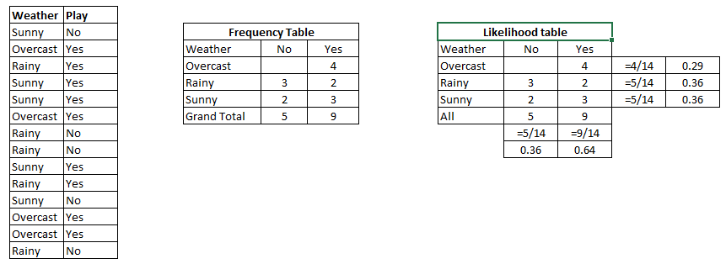
Naïve Bayes
Solution: To solve this, first consider the below dataset:

Slide 24
Naïve Bayes
We can solve it using above discussed method of posterior probability.
P(Yes | Sunny) = P( Sunny | Yes) * P(Yes) / P (Sunny)
Here we have P (Sunny |Yes) = 3/9 = 0.33, P(Sunny) = 5/14 = 0.36, P( Yes)= 9/14 = 0.64
Now, P (Yes | Sunny) = 0.33 * 0.64 / 0.36 = 0.60, which has higher probability.
Thus, A player can play on a sunny day.

Slide 25
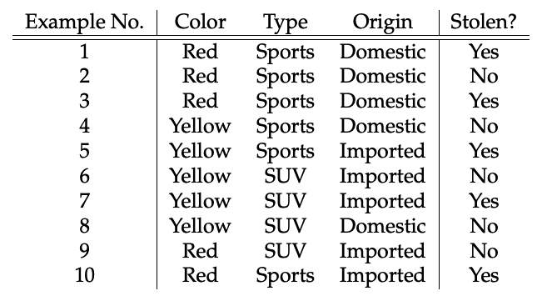
Naïve Bayes
Consider the car theft problem with attributes Color, Type, Origin, and the target, Stolen can be either Yes or No.

Slide 26
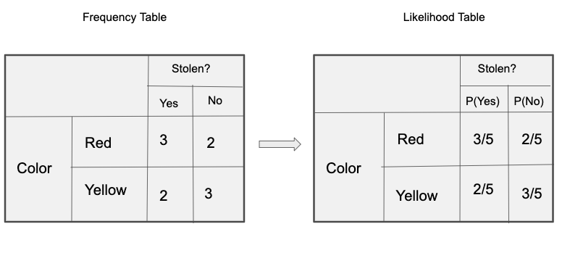
Naïve Bayes

Slide 27
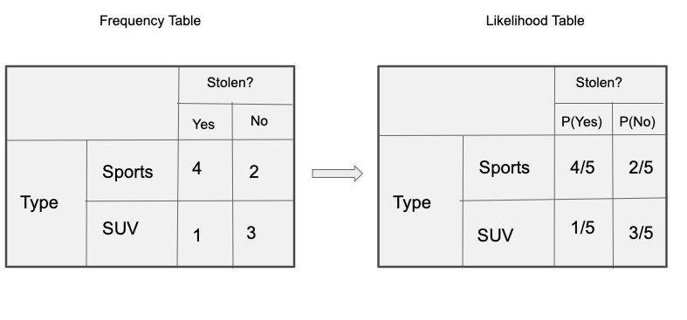
Naïve Bayes

Slide 28
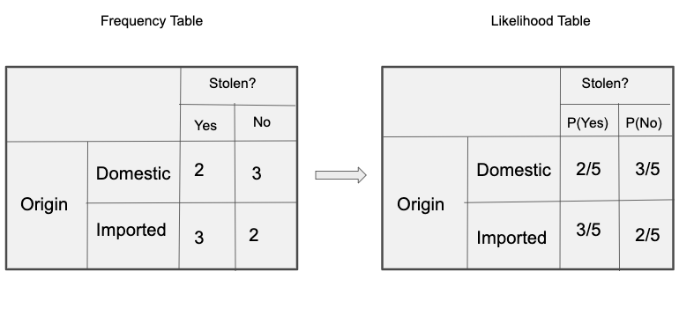
Naïve Bayes

Slide 29


Naïve Bayes
So in our Naïve Bayes, we have 3 predictors X.
As per the equations discussed above, we can calculate the posterior probability P(Yes | X) as :

Slide 30

Naïve Bayes
and, P(No | X):
Since 0.144 > 0.048, Which means given the features RED SUV and Domestic, our Naïve Bayes gets classified as ’NO’ the car is not stolen.

Slide 31
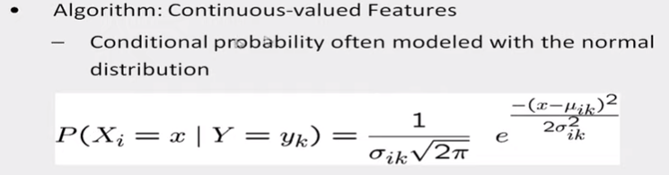
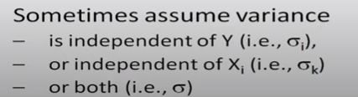
Naïve Bayes
A Gaussian distribution is usually chosen to represent the class-conditional probability for continuous attributes.

Slide 32
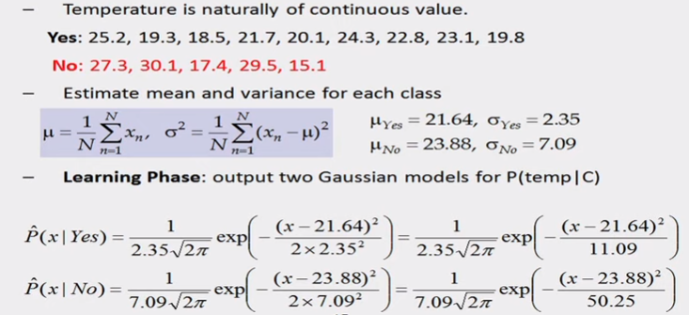
Naïve Bayes

Slide 33
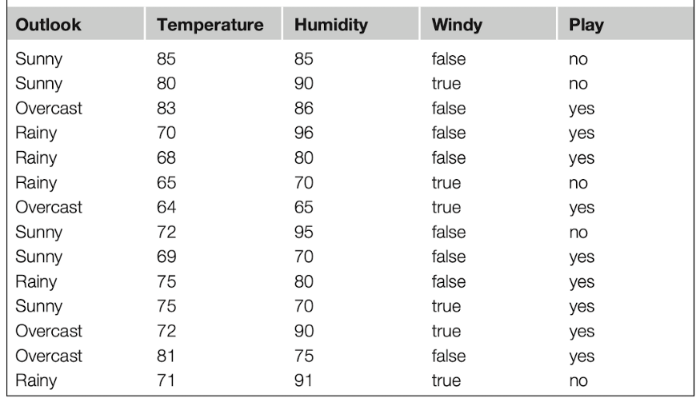
Naïve Bayes

Slide 34
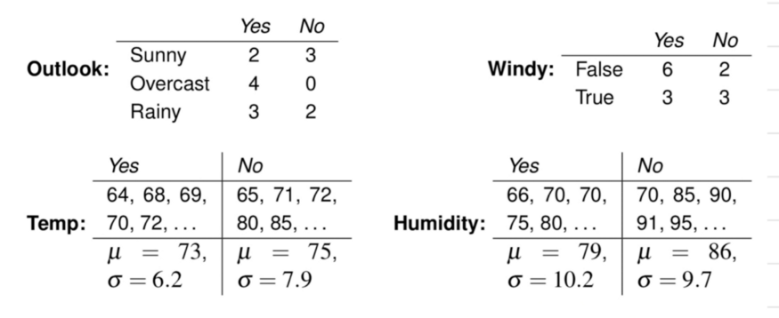
Naïve Bayes

Slide 35
Naïve Bayes
likelihood for play=yes
P(x/yes) * P(yes) = P(sunny/yes) * P(Temperature=66/yes) * P(Humidity=90/yes) * P(True/yes) * P(yes)
likelihood for play=no
P(x/no) * P(no) = P(sunny/no) * P(Temperature=66/no) * P(Humidity=90/no) * P(True/no) * P(no)
P(sunny/yes) = 2/9
P(Temperature=66/yes) = 0.034
P(Humidity=90/yes) = 0.0221
P(True/yes) = 3/9
and
P(sunny/no) = 3/5
P(Temperature=66/no) = 0.0279
P(Humidity=90/no) = 0.0381
P(True/no) = 3/5
P(x/yes) * P(yes) = (2/9) * 0.034 * 0.0221 * (3/9) * (9/14) = 0.000036
P(x/no) * P(no) = (3/5) * 0.0279* 0.0381* (3/5) * (5/14) = 0.008137
0.008137 > 0.000036
Classification — NO

Slide 36
Topic Objective
The objective of the topic is to make the student able to understand about :
.Naive Bayes Pros and Cons
Recap
Students learnt the Naïve Bayes algorithms

Slide 37
PROS AND CONS OF NAÏVE’S BAYES
Pros:
It is easy and fast to predict class of test data set. It also perform well in multi class prediction
When assumption of independence holds, a Naive Bayes classifier performs better compare to other models like logistic regression and you need less training data.
It perform well in case of categorical input variables compared to numerical variable(s). For numerical variable, normal distribution is assumed (bell curve, which is a strong assumption).

Slide 38
PROS AND CONS OF NAÏVE’S BAYES
Cons:
If categorical variable has a category (in test data set), which was not observed in training data set, then model will assign a 0 (zero) probability and will be unable to make a prediction. This is often known as “Zero Frequency”.

Slide 39
Topic Objective
The objective of the topic is to make the student able to understand about :
.Bayesian Belief Network
Recap
Students learnt the Pros and cons of Naïve bayes algorithms

Slide 40
BAYESIAN BELIEF NETWORK
A Bayesian network is a probabilistic graphical model which represents a set of variables and their conditional dependencies using a directed acyclic graph.
It is also called a Bayes network, belief network, decision network, or Bayesian model.
Bayesian networks are probabilistic, because these networks are built from a probability distribution, and also use probability theory for prediction and anomaly detection.
Bayesian Network can be used for building models from data and experts opinions, and it consists of two parts:
Directed Acyclic Graph
Table of conditional probabilities.

Slide 41
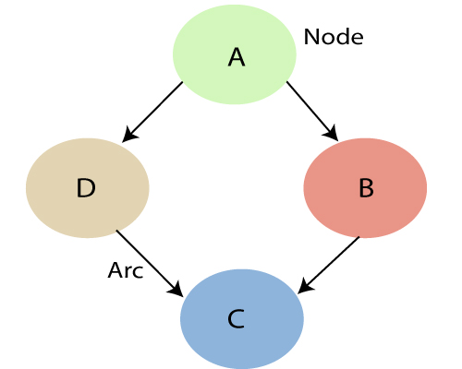
BAYESIAN BELIEF NETWORK
A Bayesian network graph is made up of nodes and Arcs (directed links), where:

Slide 42
BAYESIAN BELIEF NETWORK
Each node corresponds to the random variables, and a variable can be continuous or discrete.
Arc or directed arrows represent the causal relationship or conditional probabilities between random variables.
These directed links or arrows connect the pair of nodes in the graph.
These links represent that one node directly influence the other node, and if there is no directed link that means that nodes are independent with each other
In the above diagram, A, B, C, and D are random variables represented by the nodes of the network graph.
If we are considering node B, which is connected with node A by a directed arrow, then node A is called the parent of Node B.
Node C is independent of node A.

Slide 43
BAYESIAN BELIEF NETWORK
Example: Harry installed a new burglar alarm at his home to detect burglary. The alarm reliably responds at detecting a burglary but also responds for minor earthquakes. Harry has two neighbors David and Sophia, who have taken a responsibility to inform Harry at work when they hear the alarm. David always calls Harry when he hears the alarm, but sometimes he got confused with the phone ringing and calls at that time too. On the other hand, Sophia likes to listen to high music, so sometimes she misses to hear the alarm. Here we would like to compute the probability of Burglary Alarm.
Problem: Calculate the probability that alarm has sounded, but there is neither a burglary, nor an earthquake occurred, and David and Sophia both called the Harry.

Slide 44
BAYESIAN BELIEF NETWORK
The Bayesian network for the above problem is given below. The network structure is showing that burglary and earthquake is the parent node of the alarm and directly affecting the probability of alarm's going off, but David and Sophia's calls depend on alarm probability.
The network is representing that our assumptions do not directly perceive the burglary and also do not notice the minor earthquake, and they also not confer before calling.
The conditional distributions for each node are given as conditional probabilities table or CPT.
Each row in the CPT must be sum to 1 because all the entries in the table represent an exhaustive set of cases for the variable.
In CPT, a boolean variable with k boolean parents contains 2^{K} probabilities. Hence, if there are two parents, then CPT will contain 4 probability value

Slide 45
BAYESIAN BELIEF NETWORK
List of all events occurring in this network:
Burglary (B)
Earthquake(E)
Alarm(A)
David Calls(D)
Sophia calls(S)

Slide 46
BAYESIAN BELIEF NETWORK
We can write the events of problem statement in the form of probability: P[D, S, A, B, E], can rewrite the above probability statement using joint probability distribution:
P[D, S, A, B, E]= P[D | S, A, B, E]. P[S, A, B, E]
=P[D | S, A, B, E]. P[S | A, B, E]. P[A, B, E]
= P [D| A]. P [ S| A, B, E]. P[ A, B, E]
= P[D | A]. P[ S | A]. P[A| B, E]. P[B, E]
= P[D | A ]. P[S | A]. P[A| B, E]. P[B |E]. P[E]

Slide 47
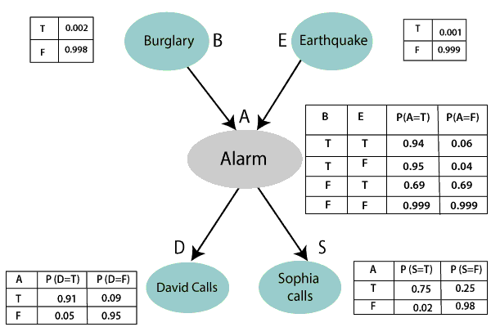
BAYESIAN BELIEF NETWORK

Slide 48
BAYESIAN BELIEF NETWORK
Let's take the observed probability for the Burglary and earthquake component:
P(B= True) = 0.002, which is the probability of burglary.
P(B= False)= 0.998, which is the probability of no burglary.
P(E= True)= 0.001, which is the probability of a minor earthquake
P(E= False)= 0.999, Which is the probability that an earthquake not occurred.

Slide 49
BAYESIAN BELIEF NETWORK
Conditional probability table for Alarm A:
The Conditional probability of Alarm A depends on Burglar and earthquake:
B | E | P(A= True) | P(A= False)
True | True | 0.94 | 0.06
True | False | 0.95 | 0.04
False | True | 0.31 | 0.69
False | False | 0.001 | 0.999

Slide 50
BAYESIAN BELIEF NETWORK
Conditional probability table for David Calls:
The Conditional probability of David that he will call depends on the probability of Alarm.
A | P(D= True) | P(D= False)
True | 0.91 | 0.09
False | 0.05 | 0.95
Conditional probability table for Sophia Calls:
The Conditional probability of Sophia that she calls is depending on its Parent Node "Alarm."
A | P(S= True) | P(S= False)
True | 0.75 | 0.25
False | 0.02 | 0.98

Slide 51
BAYESIAN BELIEF NETWORK
From the formula of joint distribution, we can write the problem statement in the form of probability distribution:
P(S, D, A, ¬B, ¬E) = P (S|A) *P (D|A)*P (A|¬B ^ ¬E) *P (¬B) *P (¬E).
= 0.75* 0.91* 0.001* 0.998*0.999
= 0.00068045.
Hence, a Bayesian network can answer any query about the domain by using Joint distribution.

Slide 52
Topic Objective
The objective of the topic is to make the student able to understand about :
Ensemble Methods
Recap
Students learnt the Bayesian Belief network

Slide 53
Ensemble Methods
Ensemble learning helps improve machine learning results by combining several models. This approach allows the production of better predictive performance compared to a single model. Basic idea is to learn a set of classifiers (experts) and to allow them to vote.
Bagging and Boosting are two types of Ensemble Learning. These two decrease the variance of a single estimate as they combine several estimates from different models. So the result may be a model with higher stability

Slide 54
Ensemble Methods
Bagging: It is a homogeneous weak learners’ model that learns from each other independently in parallel and combines them for determining the model average.
Boosting: It is also a homogeneous weak learners’ model but works differently from Bagging. In this model, learners learn sequentially and adaptively to improve model predictions of a learning algorithm.

Slide 55
Topic Objective
The objective of the topic is to make the student able to understand about :
Ensemble Methods (Bagging)
Recap
Students learnt the Ensemble methods

Slide 56
Bagging
Bootstrap Aggregating, also known as bagging, is a machine learning ensemble meta-algorithm designed to improve the stability and accuracy of machine learning algorithms used in statistical classification and regression.
It decreases the variance and helps to avoid overfitting. It is usually applied to decision tree methods. Bagging is a special case of the model averaging approach.

Slide 57
Bagging
Description of the Technique
Suppose a set D of d tuples, at each iteration i, a training set D_{i} of d tuples is selected via row sampling with a replacement method (i.e., there can be repetitive elements from different d tuples) from D (i.e., bootstrap). Then a classifier model Mi is learned for each training set D < i. Each classifier M_{i} returns its class prediction. The bagged classifier M* counts the votes and assigns the class with the most votes to X (unknown sample).

Slide 58
Bagging
Implementation Steps of Bagging
Step 1: Multiple subsets are created from the original data set with equal tuples, selecting observations with replacement.
Step 2: A base model is created on each of these subsets.
Step 3: Each model is learned in parallel with each training set and independent of each other.
Step 4: The final predictions are determined by combining the predictions from all the models.

Slide 59
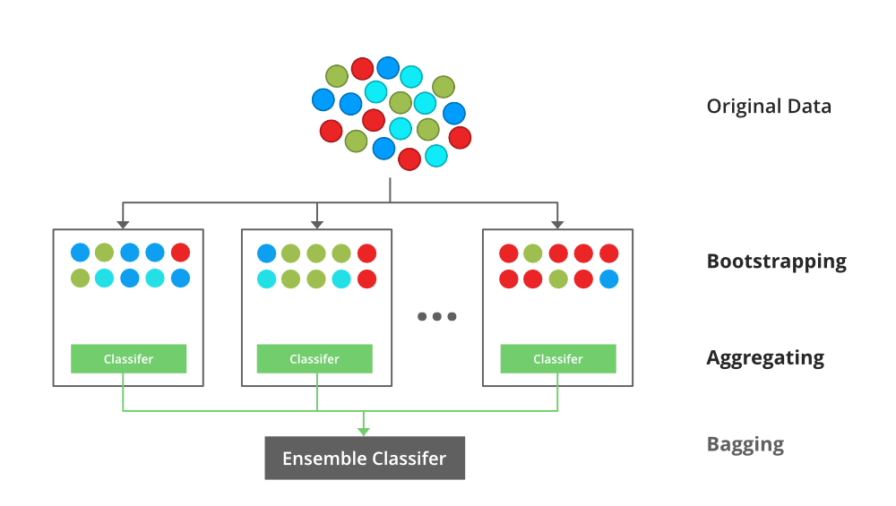
Bagging

Slide 60
Bagging
Example of Bagging
The Random Forest model uses Bagging, where decision tree models with higher variance are present. It makes random feature selection to grow trees. Several random trees make a Random Forest

Slide 61
Topic Objective
The objective of the topic is to make the student able to understand about :
Ensemble Methods (Boosting)
Recap
Students learnt thethe Bagging

Slide 62
Boosting
Boosting is an ensemble modeling technique that attempts to build a strong classifier from the number of weak classifiers. It is done by building a model by using weak models in series. Firstly, a model is built from the training data. Then the second model is built which tries to correct the errors present in the first model. This procedure is continued and models are added until either the complete training data set is predicted correctly or the maximum number of models is added.

Slide 63
Boosting
There are several boosting algorithms. The original ones, proposed by Robert Schapire and Yoav Freund were not adaptive and could not take full advantage of the weak learners. Schapire and Freund then developed AdaBoost, an adaptive boosting algorithm that won the prestigious Gödel Prize. AdaBoost was the first really successful boosting algorithm developed for the purpose of binary classification. AdaBoost is short for Adaptive Boosting and is a very popular boosting technique that combines multiple “weak classifiers” into a single “strong classifier”.

Slide 64
Boosting
Bagging and Boosting, both being the commonly used methods, have a universal similarity of being classified as ensemble methods. Here we will explain the similarities between them.
Both are ensemble methods to get N learners from 1 learner.
Both generate several training data sets by random sampling.
Both make the final decision by averaging the N learners (or taking the majority of them i.e Majority Voting).
Both are good at reducing variance and provide higher stability.

Slide 65
Topic Objective
The objective of the topic is to make the student able to understand about :
Bagging & boosting impact
Recap
Students learnt the Boosting.

Slide 66
Bagging & boosting and its impact on bias and variance
Prediction errors are defined as the collection of bias, variance, and irreducible errors. We can refer to the irreducible error as noise since we cannot reduce it, regardless of the algorithm chosen. The focus of this article is on the errors of bias and variance. The goal is to understand the two errors. We shall explore their relationship with each other and how ensemble methods affect them.

Slide 67
Bagging & boosting and its impact on bias and variance
Bias Error: High bias refers to when a model shows high inclination towards an outcome of a problem it seeks to solve. It is highly biased towards the given problem. This leads to a difference between estimated and actual results. When the bias is high, the model is most likely not learning enough from the training data.
It does not learn the key features therefore the resulting predictions are unreliable, and the generalization is poor. This is what is known as underfitting.

Slide 68
Bagging & boosting and its impact on bias and variance
Bias Error: High bias refers to when a model shows high inclination towards an outcome of a problem it seeks to solve. It is highly biased towards the given problem. This leads to a difference between estimated and actual results. When the bias is high, the model is most likely not learning enough from the training data.
It does not learn the key features therefore the resulting predictions are unreliable, and the generalization is poor. This is what is known as underfitting.

Slide 69
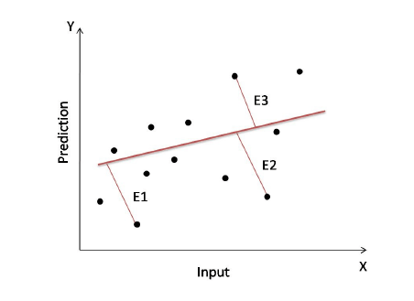
Bagging & boosting and its impact on bias and variance

Slide 70
Bagging & boosting and its impact on bias and variance
Variance error: The sensitivity of models to slight fluctuations in the training data describes the variance. When a function fits a bit too close to a given number of data points, we say that the model is overfitting. High variance is an indication of overfitting.
To deal with this, we can get more training data if the data is inadequate. We could also use a less complex model.

Slide 71
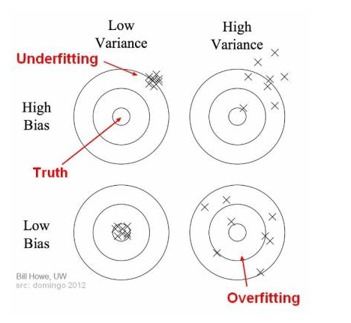
Bagging & boosting and its impact on bias and variance
It is desirable to achieve a low bias and variance to ensure accurate predictions. High bias and high variance hint at lower performance.
.

Slide 72
Bagging & boosting and its impact on bias and variance
Bagging is meant to reduce the variance without increasing the bias. This technique is especially effective where minute changes in a learner’s training set lead to huge changes in the predicted output. Bagging reduces the variance by aggregating individual models. These models have dissimilar statistical properties like the means and standard deviations, among others

Slide 73
Topic Objective
The objective of the topic is to make the student able to understand about :
C5.0 Boosting
Recap
Students learnt the Bagging and boosting and its impact on bias and variance.

Slide 74
C5.0 Boosting
C5.0 is adaptive boosting, based on the work of Rob Schapire and Yoav Freund. The idea is to generate several classifiers (either decision trees or rulesets) rather than just one. When a new case is to be classified, each classifier votes for its predicted class and the votes are counted to determine the final class.

Slide 75
C5.0 Boosting
But how can we generate several classifiers from a single dataset?
As the first step, a single decision tree or ruleset is constructed as before from the training data (e.g. hypothyroid.data).
This classifier will usually make mistakes on some cases in the data; the first decision tree, for instance, gives the wrong class for 7 cases in hypothyroid.data. When the second classifier is constructed, more attention is paid to these cases in an attempt to get them right.
As a consequence, the second classifier will generally be different from the first. It also will make errors on some cases, and these become the the focus of attention during construction of the third classifier
. This process continues for a pre-determined number of iterations or trials, but stops if the most recent classifiers is either extremely accurate or inaccurate.

Slide 76
Topic Objective
The objective of the topic is to make the student able to understand about :
Random Forest
Recap
Students learnt the C5.0 Boosting

Slide 77
Random Forest
Random Forest is a popular machine learning algorithm that belongs to the supervised learning technique. It can be used for both Classification and Regression problems in ML. It is based on the concept of ensemble learning, which is a process of combining multiple classifiers to solve a complex problem and to improve the performance of the model.
"Random Forest is a classifier that contains a number of decision trees on various subsets of the given dataset and takes the average to improve the predictive accuracy of that dataset." Instead of relying on one decision tree, the random forest takes the prediction from each tree and based on the majority votes of predictions, and it predicts the final output.
The greater number of trees in the forest leads to higher accuracy and prevents the problem of overfitting.

Slide 78
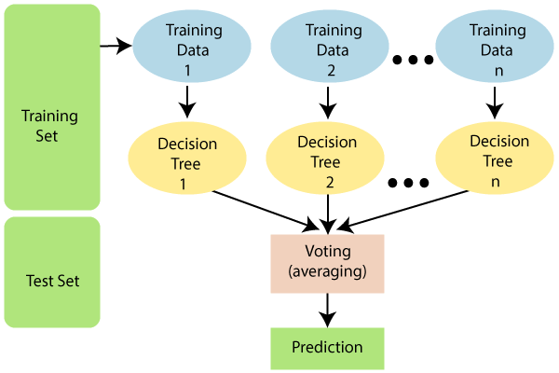
Random Forest

Slide 79
Random Forest
The random forest combines multiple trees to predict the class of the dataset, it is possible that some decision trees may predict the correct output, while others may not. But together, all the trees predict the correct output. Therefore, below are two assumptions for a better Random forest classifier:
There should be some actual values in the feature variable of the dataset so that the classifier can predict accurate results rather than a guessed result.
The predictions from each tree must have very low correlations.

Slide 80
Random Forest
Below are some points that explain why we should use the Random Forest algorithm:
<="" li="">It takes less training time as compared to other algorithms.
It predicts output with high accuracy, even for the large dataset it runs efficiently.
It can also maintain accuracy when a large proportion of data is missing.

Slide 81
Random Forest
The Working process can be explained in the below steps and diagram:
Step-1: Select random K data points from the training set.
Step-2: Build the decision trees associated with the selected data points (Subsets).
Step-3: Choose the number N for decision trees that you want to build.
Step-4: Repeat Step 1 & 2.
Step-5: For new data points, find the predictions of each decision tree, and assign the new data points to the category that wins the majority votes.

Slide 82
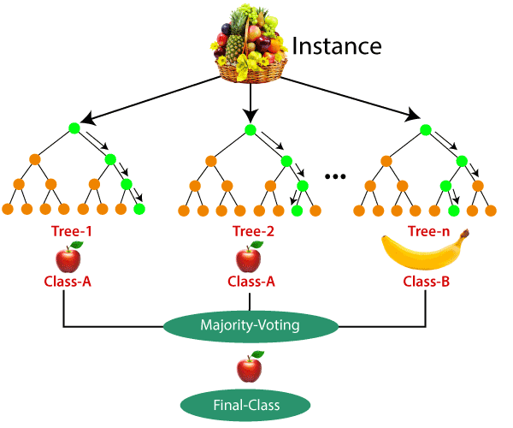
Random Forest
Suppose there is a dataset that contains multiple fruit images. So, this dataset is given to the Random forest classifier. The dataset is divided into subsets and given to each decision tree. During the training phase, each decision tree produces a prediction result, and when a new data point occurs, then based on the majority of results, the Random Forest classifier predicts the final decision. Consider the below image:

Slide 83
Topic Objective
The objective of the topic is to make the student able to understand about :
Gradient Boosting
Recap
Students learnt the Random Forest

Slide 84
Gradient Boosting
Gradient Boosting Machine (GBM) is one of the most popular forward learning ensemble methods in machine learning. It is a powerful technique for building predictive models for regression and classification tasks.
GBM helps us to get a predictive model in form of an ensemble of weak prediction models such as decision trees. Whenever a decision tree performs as a weak learner then the resulting algorithm is called gradient-boosted trees.
It enables us to combine the predictions from various learner models and build a final predictive model having the correct prediction.

Slide 85
Gradient Boosting
But here one question may arise if we are applying the same algorithm then how multiple decision trees can give better predictions than a single decision tree? Moreover, how does each decision tree capture different information from the same data?
The answer to these questions is that a different subset of features is taken by the nodes of each decision tree to select the best split. It means, that each tree behaves differently, and hence captures different signals from the same data.

Slide 86
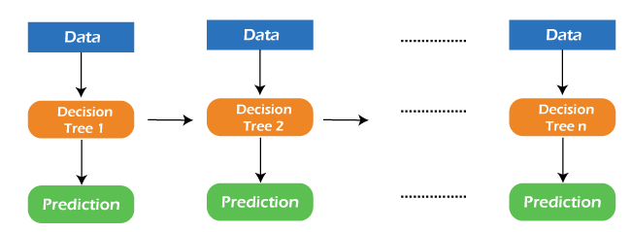
Gradient Boosting

Slide 87
Gradient Boosting
But there are some supervised algorithms in ML that depend on a combination of various models together through the ensemble. In other words, when multiple base models contribute their predictions, an average of all predictions is adapted by boosting algorithms.
Gradient boosting machines consist 3 elements as follows:
Loss function
Weak learners
Additive model

Slide 88
Topic Objective
The objective of the topic is to make the student able to understand about :
XG Boost
Recap
Students learnt the Gradient Boosting.

Slide 89
XG Boost
Gradient boosted decision trees are implemented by the XGBoost library of Python, intended for speed and execution, which is the most important aspect of ML (machine learning).
XgBoost: XgBoost (Extreme Gradient Boosting) library of Python was introduced at the University of Washington by scholars. It is a module of Python written in C++, which helps ML model algorithms by the training for Gradient Boosting.
Gradient boosting: This is an AI method utilized in classification and regression assignments, among others. It gives an expectation model as a troupe of feeble forecast models, commonly called decision trees.

Slide 90
XG Boost
A loss function should be improved, which implies bringing down the loss function better than the result.
To make expectations, weak learners are used in the model
Decision trees are utilized in this, and they are utilized in a jealous way, which alludes to picking the best-divided focuses in light of Gini Impurity and so forth or to limit the loss function
The additive model is utilized to gather every one of the frail models, limiting the loss function.
Trees are added each, ensuring existing trees are not changed in the decision tree. Regularly angle plummet process is utilized to find the best hyper boundaries, post which loads are refreshed further.

Slide 91
XG Boost
What Makes XGBoost So Famous?
Execution and Speed: Originally built on C++, it is similarly fast to other gathering classifiers.
Center calculation is parallelizable: it can outfit the force of multi-center PCs because the center XGBoost calculation is parallelizable. Moreover, it is parallelizable onto GPUs and across organizations of PCs, making it attainable to prepare on a huge dataset.
Reliably outflanks other technique calculations: It has shown better output on many AI benchmark datasets.
Wide assortment of tuning boundaries: XGBoost inside has boundaries for scikit-learn viable API, missing qualities, regularization, cross-approval, client characterized objective capacities, tree boundaries, etc.
XGBoost (Extreme Gradient Boosting) has a place with a group of helping calculations and utilizations of the slope supporting (GBM) structure at its center.

Slide 92
Daily Quiz
1. Which of the following is true about Naive Bayes ?
a) Assumes that all the features in a dataset are equally important
b) Assumes that all the features in a dataset are independent
c)Both A and B
d)None of the above
2. Where does the bayes rule can be used? a) Solving queries b) Increasing complexity c) Decreasing complexity d) Answering probabilistic query

Slide 93
Daily Quiz
3. What does the bayesian network provides? a) Complete description of the domain b) Partial description of the domain c) Complete description of the problem d) None of the mentioned
4. How the compactness of the Bayesian network can be described? a) Locally structured b) Fully structured c) Partial structure d) All of the mentioned

Slide 94
Daily Quiz
5. How many terms are required for building a bayes model? a) 1 b) 2 c) 3 d) 4
6. What is needed to make probabilistic systems feasible in the world? a) Reliability b) Crucial robustness c) Feasibility d) None of the mentioned
7. Where does the bayes rule can be used? a) Solving queries b) Increasing complexity c) Decreasing complexity d) Answering probabilistic query

Slide 95
Daily Quiz
8. How the entries in the full joint probability distribution can be calculated? a) Using variables b) Using information c) Both Using variables & information d) None of the mentioned
9. How the bayesian network can be used to answer any query? a) Full distribution b) Joint distribution c) Partial distribution d) All of the mentioned

Slide 96
Daily Quiz
10.To which does the local structure is associated? a) Hybrid b) Dependant c) Linear d) None of the mentioned

Slide 97
Weekly Assignment
Explain the concept of Bayes theorem with an example.
2. Explain Bayesian belief network and conditional independence with example.
3. What are Bayesian Belief nets? Where are they used?
4. Explain Brute force MAP hypothesis learner? What is minimum description length principle.

Slide 98
Weekly Assignment
5. Explain Brute force Bayes Concept Learning
6. Explain the concept of EM Algorithm.
7. What is Gradient Boosting?
8. Explain Naïve Bayes Classifier with an Example.
9. Describe the concept of Random Forest
10. Define
(i) Prior Probability
(ii) Conditional Probability
(iii) XG Boost

Slide 99
MCQ s
1. _____ is the mathematical likelihood that something will occur.
Classification.
Probability.
Naive Bayes Classifier.
None of the other answers are correct.
2. The Naive Bayes Classifier is a _____ in probability.
Technique.
Process.
Classification.
None of these answers are correct.

Slide 100
MCQ s
3) If you remove the following any one red points from the data. Does the decision boundary will change?
A) Yes B) No
4) If you remove the non-red circled points from the data, the decision boundary will change?
A) True B) False

Slide 101
MCQ s
5.What is the consequence between a node and its predecessors while creating bayesian network? a) Functionally dependent b) Dependant c) Conditionally independent d) Both Conditionally dependant & Dependant

Slide 102
Expected Questions for University Exam
Explain the various types of issues in machine learning.
Define the learning classifiers.
Differentiated between Bayesian Learning and Instance based Learning.
Discuss various Artificial Neural Network Architectures.
Explain back propagation algorithm and derive expressions for weight update relations.

Slide 103
Glossary Questions
1. Choose correct option
i. Selection of Kernel and parameter ii. Classification iii. Overfitting iv) noisy
a. Naive Bayes are a collection------------------of algorithms
b. The effectiveness of an SVM depends upon---
c. The SVM’s are less effective if data is …
d. If I am using all features of my dataset and I achieve 100% accuracy on my training set, but ~70% on validation set, what should I look out for….

Slide 104
.
Glossary Questions
2. Classification _____ a set of objects based on similarity.
3.___________ is the mathematical likelihood that something will occur
4. The Naive Bayes Classifier is a _____ in probability.
5._____________is an ensemble method.
Technique, proability, technique, boosting, Navie bias, claassifiction, grouping.

Slide 105
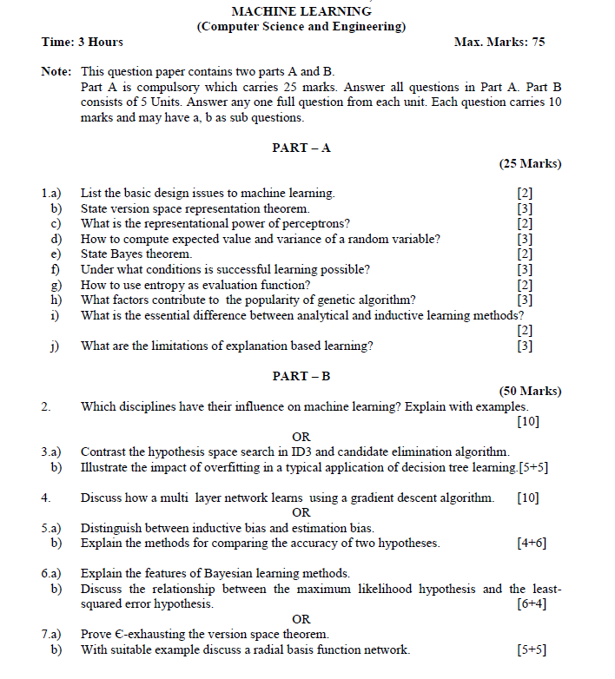
Old Question Papers

Slide 106
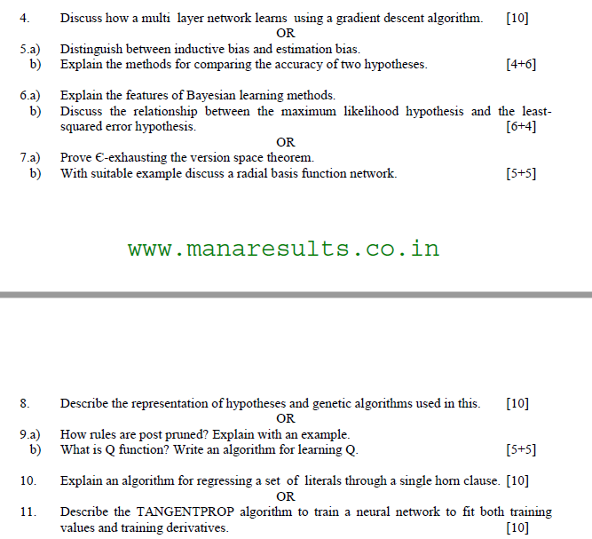
Old Question Papers

Slide 107

Old Question Papers

Slide 108
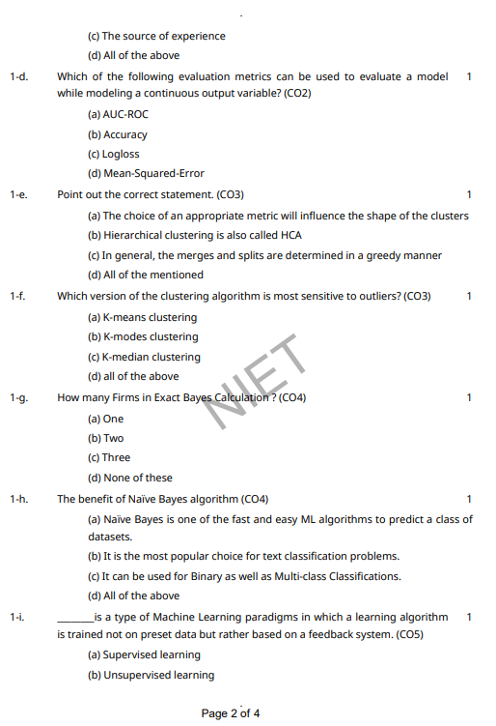
Old Question Papers

Slide 109
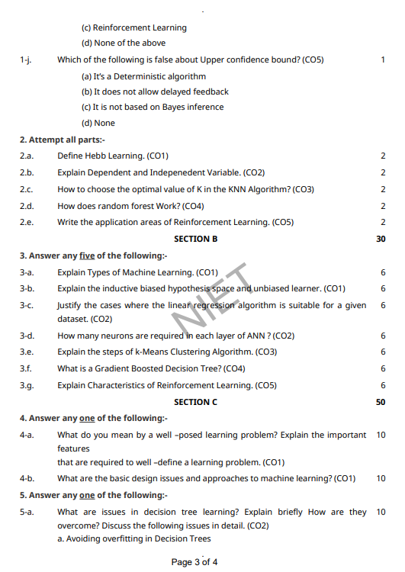
Old Question Papers

Slide 110
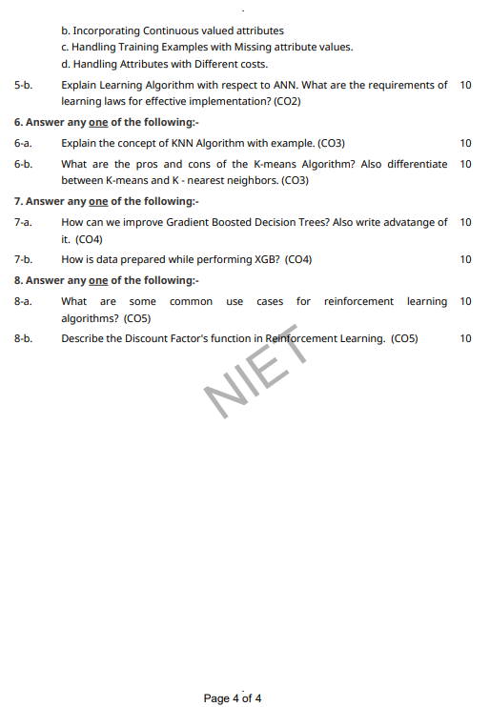
Old Question Papers

Slide 111
Expected Questions for University Exam
What is cluster analysis?
What is the goal of clustering analysis?
What is the difference between supervised learning and unsupervised learning?
What is Euclidean distance?
What is centroid?
What is the different between exploratory and confirmatory & explanatory analysis?
What is K-Means algorithm?
What are the pros and cons of the K-Means algorithm?

Slide 112
References
Text books:
1. Tom M. Mitchell, ―Machine Learning, McGraw-Hill Education (India) Private Limited, 2013.
2. Ethem Alpaydin, ―Introduction to Machine Learning (Adaptive Computation and Machine Learning), The MIT Press 2004.
3. Stephen Marsland, ―Machine Learning: An Algorithmic Perspective, CRC Press, 2009.
4. Bishop, C., Pattern Recognition and Machine Learning. Berlin: Springer-Verlag.

Slide 113
Recap
Bayesian Learning
Naïve Bayes
Bayesian Belief Networks
Combine prior knowledge with observed data
• Impact of prior knowledge (when correct!) is to lower the sample complexity
• Active research area:
1. Extend from boolean to real-valued variables
2. Parameterized distributions instead of tables
3. Extend to first-order instead of propositional systems
4. More effective inference methods

Slide 114
Recap
Ensemble methods
Bagging
Boosting
Pros and cons of Bagging and Boosting
Impact of bagging and boosting on variance
Ensemble methods
Random Forest
Gradient boosting
XG boost

